Slide 1











Relational Database Management System
Cineflix
by
TEAM TARANGA
01

Slide 2
Overview
The Movie Ticket Management System streamlines ticket purchases by enabling admins to manage movies and screenings while providing users with a simple way to view and book available tickets.
02

Slide 3
Role of Relational Database
01
02
03
04
Data Organization
Data Integrity
Data Retrieval
Data Security
03

Slide 4
DATABASE FEATURES
User/ Admin authentication
Stores profile data
Stores and retrieves movie informations
Insert, Update, Delete movie data
Stores seat informations
Maintains user purchase history
04
Searching and Filtering

Slide 5
DATABASE FEATURES
Profit Analytics and Profit count
Managing Screening Info
Customer Purchasing time and price identified by ID
05

Slide 6
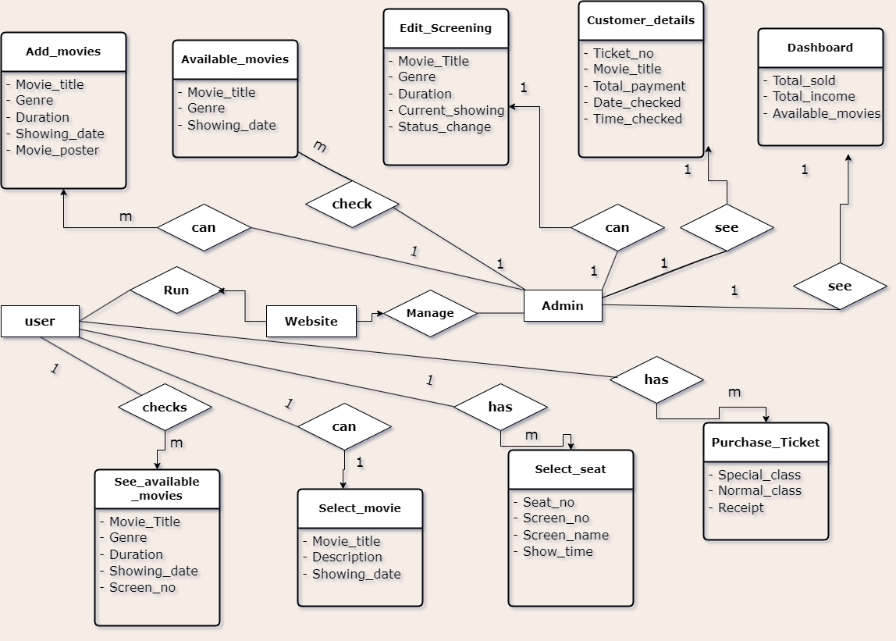
RDB DESIGN :Entity-Relationship Diagram(ERD)
06

Slide 7
Implementation Details
01.
Javafx
02.
JDBC
03.
GITHUB
07

Slide 8
THANK YOU VERY MUCH!

